Slide 1
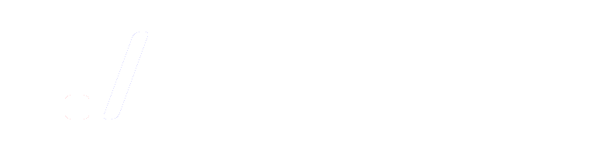






--------- The Software Developers Association (./SoDA) ---------
T h e 3 r d A n n u a l
======= ======= ========= ===========
// // \\ || \\ ||
|| || || || || ||
|| || || || || ||======
|| || || || || ||
\\ \\ // || // ||
======= ======= ========= ===========
C H A L L E N G E
1
2
3
4
5
6
7
8
9
10
11
12
SATURDAY, February 18, 2017 · 9:00 am – 2:00 pm · BAC 316
thesoda.io

